Slide 1
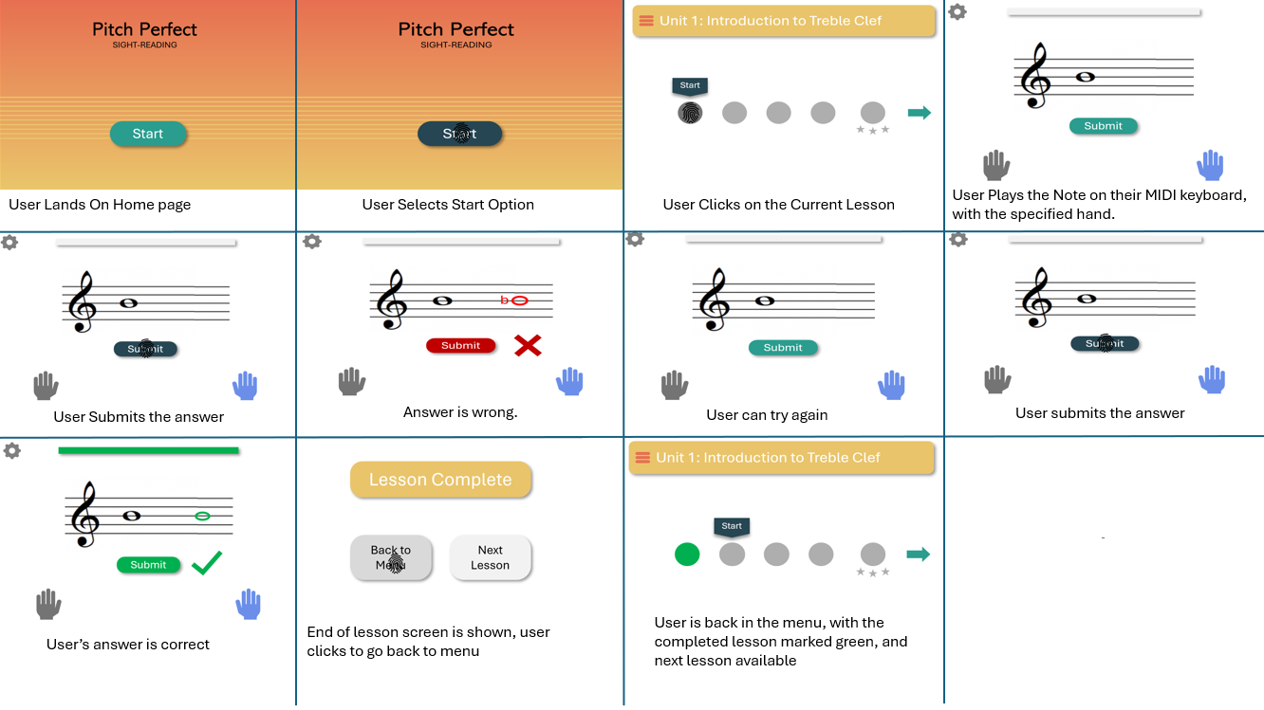
Storyboard – Lesson with MIDI Keyboard

Slide 2
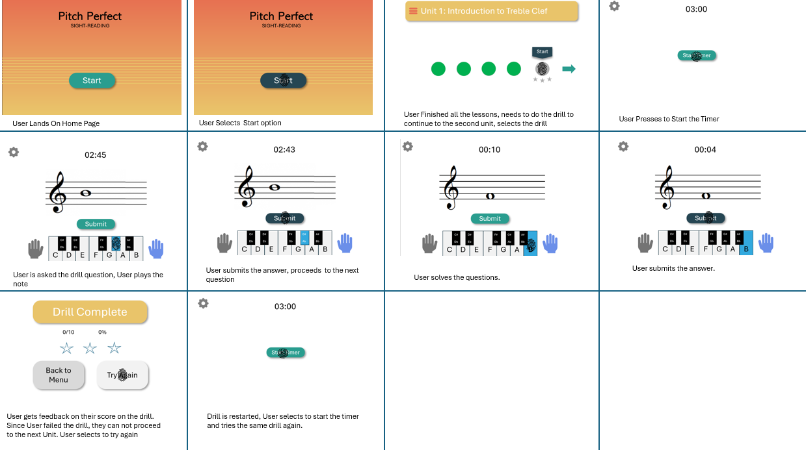
Storyboard – Unsuccessful Drill

Slide 3
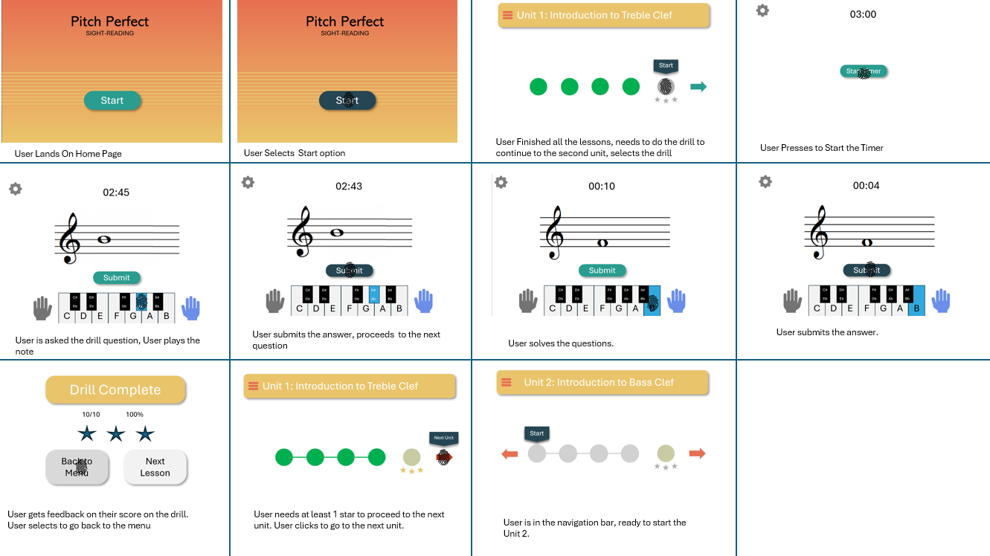
Storyboard – Successful Drill

